Slide 1
Easy Power
Predictor

Slide 2
Our Team
A-45 Shreya Gandhi
A-46 Vipul Ghodke
A-47 Nisha Gurav
A-48 Shreyansh Kahate (Team Leader)
Project Mentor : Mrs. Kanchan Khedikar

Slide 3
Idea of Project
In this era of rapid growth, a noticeable disparity persists between the production and consumption of electricity. The advent of renewable energy sources has further widened this gap, leading to instances of overproduction and substantial electricity loss due to inadequate utilization. Simultaneously, the escalating demand for electricity occasionally results in insufficient power provision.
To address and bridge this gap, the key lies in accurately understanding power requirements. Our objective is to develop a predictive model utilizing machine learning, which will forecast power consumption based on various parameters. These predictions aim to proactively anticipate the rising energy demands, facilitating more efficient and responsive energy management.

Slide 4
Background
Sr.No | Title | Year | Publisher | Approach
1 | Empirical Mode Decomposition Based Deep Learning for Electricity Demand Forecasting | 2018 | IEEE | Significance of electricity demand and prediction using Deep Learning and ANN
2 | Investigation of Performance of Electric Load Power Forecasting in Multiple Time Horizons with New Architecture Realized in Multivariate Linear Regression & Feed-Forward Neural Network Techniques | 2020 | IEEE | Load forecasting using multivariate linear regression and feed-forward neural network techniques
3 | Electricity consumption forecasting based on ensemble deep learning with application to the Algerian market | 2021 | ScienceDirect | Deep Learning with LSTM ,GRU, Models
4 | Electric Heating and the Effects of Temperature on Household Electricity Consumption in South Africa | 2019 | Energy Institute at Haas | Log-linear correlation between cold temperature and electricity consumption
5 | Research on Deep Learning Energy Consumption Prediction Based on Generating Confrontation Network | 2019 | IEEE | Deep learning, convolutional neural network model

Slide 5
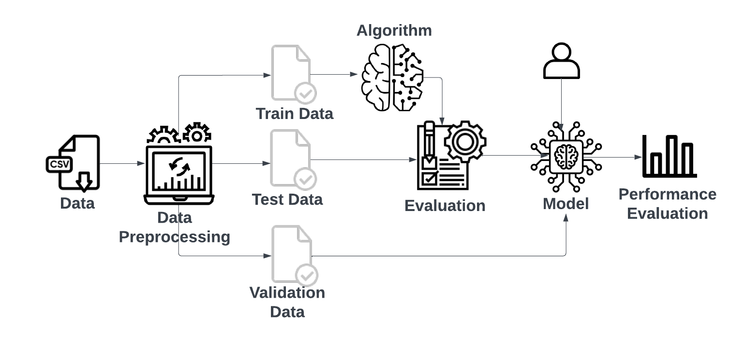
System Architecture

Slide 6
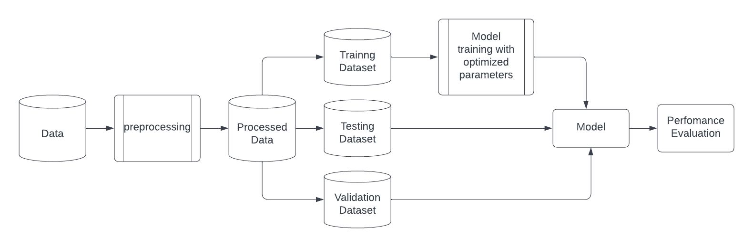
Flowchart

Slide 7
Methodology
Data Acquisition
Data Cleaning and Preprocessing:
Data Merging and Transformation:
Exploratory Data Analysis (EDA):
Model Evaluation and Validation:
Results and Insights:

Slide 8
Requirements
Software Requirements: | Hardware Requirements:
IDE : VS Code , Jupyter Notebook Tools & Libraries : PowerBi , Tableau , NumPy , Pandas , Matplotlib , Scikit-learn | CPU : Intel Core i3-5th gen or above RAM : Min 8gb Disk Space : Min 100 gb Operating System : with support of all given software requirements

Slide 9
Test Plan
Training Data Evaluation : Assess model performance on training data . Look for overfitting and adjust parameters if needed.
Testing Data Evaluation : Test models on unseen data for predictive performance . Calculate MAE, MSE, RMSE, and R-squared to measure accuracy and error.
Validation Data Assessment : Validate models on a separate data subset . Ensure models generalize well and avoid overfitting .
Model Comparison and Selection : Compare models across all data splits using evaluation metrics . Select the best-fit model based on high accuracy, low error, and strong generalization.

Slide 10
Plan & Timeline
Implementation & Training of Model
Project Setup and Preparation
week 1 & 2
week 5 & 6
01
02
03
04
week 3 & 4
week 7 & 8
Learning various
Analytical techniques &
ML Models
Testing and
documentation

Slide 11
Work Distribution
Data Preprocessing and Analysis | Shreya Gandhi Nisha Gurav
Model Selection , Training and Testing | Shreyansh Kahate Vipul Ghodke

Slide 12
References
“ELECTRICITY CONSUMPTION PREDICTION USING MACHINE LEARNING” by G . Vijendar Reddy1 , Lakshmi Jaswitha Aitha1* , Ch Poojitha1 , A Naga Shreya 1 , D Krithika Reddy1 ,G Sai.Meghana1 1Department of Information Technology, GRIET, India
“Clustering of Electricity Consumption Behavior Dynamics toward Big Data Applications” by Yi Wang, Student Member, IEEE, Qixin Chen, Senior Member, IEEE, Chongqing Kang, Senior Member, IEEE, and Qing Xia, Senior Member, IEEE
“Indian Electricity System Transition and Its Challenges: A Review Article in Journal of Asian Energy Studies” ,January 2022
“Predicting the Energy Consumption of Residential Buildings for Regional Electricity Supply-Side and Demand-Side Management” by HUILING CAI 1 , SHOUPENG SHEN1,2, QINGCHENG LIN1 , XUEFENG LI1 , (Member, IEEE), AND HUI XIAO
https://www.sciencedirect.com/science/article/pii/S0360544221033090?ref=cra_js_challenge&fr=RR-1https://haas.berkeley.edu/wp-content/uploads/WP299.pdf
https://prsindia.org/policy/vital-stats/overview-issues-power-sector-india
https://www.fitchratings.com/research/corporate-finance/india-to-face-supply-challenges-rising-electricity-demand-07-04-2022
Drive Link To All Papers: https://drive.google.com/drive/folders/1wdpQbBXAFWl-iySFlu_6Mfe_aGnTqHl7?usp=sharing

Slide 13
Thank You!

